Slide 1

XAMPP
Download and install

Slide 2
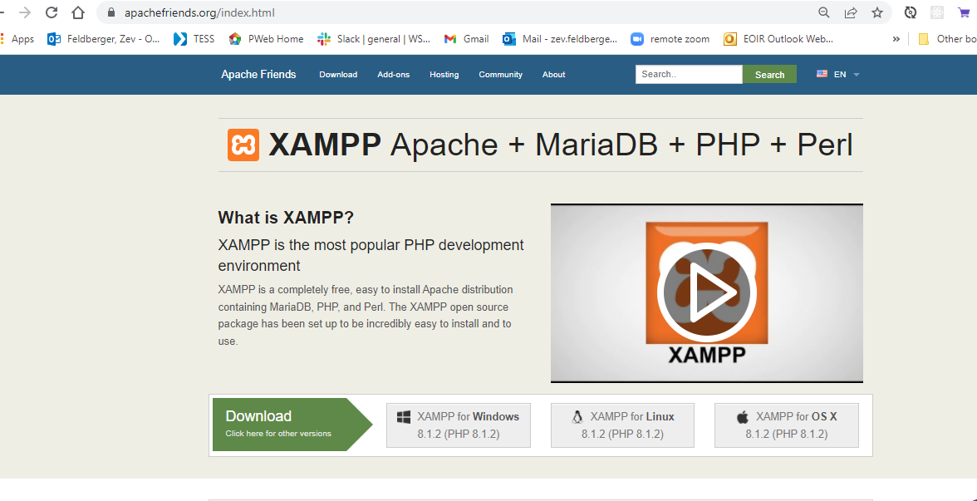


Download from Apachefriends

Slide 3

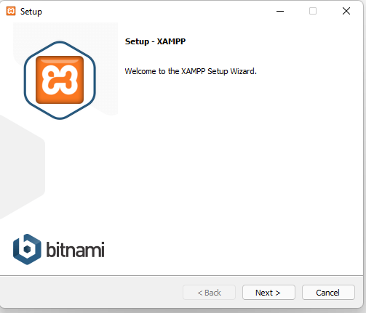
Install Accept all Defaults

Slide 4
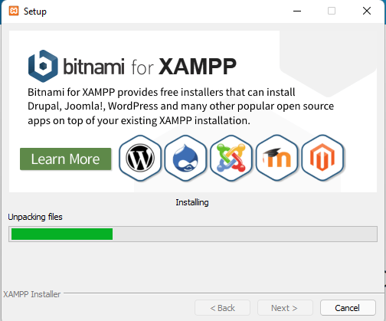
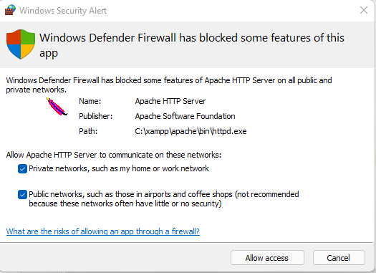


Install - Allow Access

Slide 5
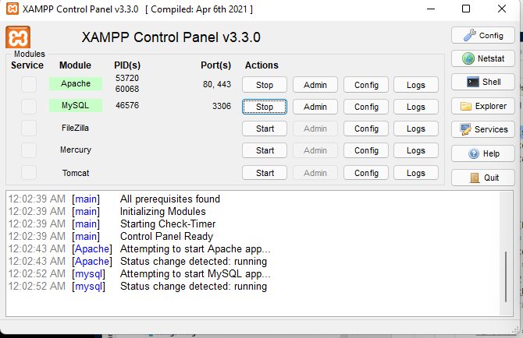
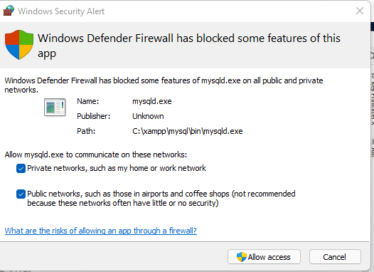


Run - Allow Access
Turn on Apache Server and MySQL Server

Slide 6
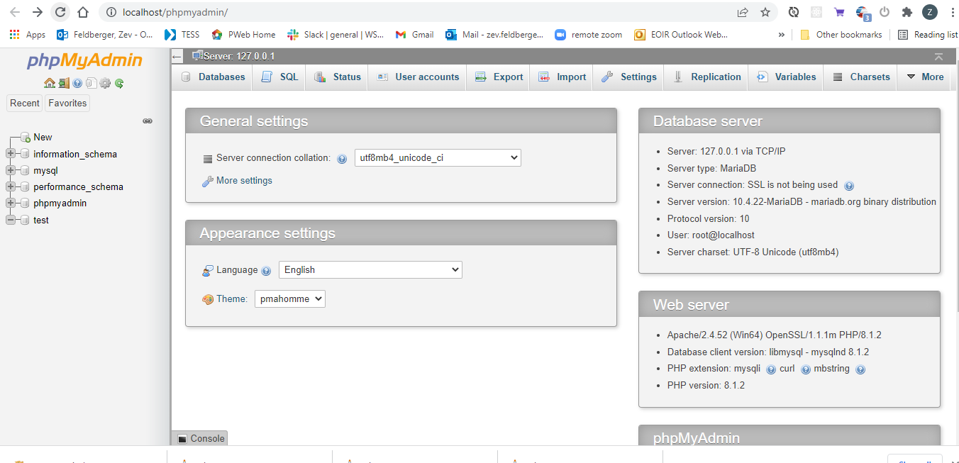
Admin page

